Slide 1
GREEN PROGRAMMING
Tina Ulbrich – Hendrik Niemeyer
ROSEN Technology and Research GmbH
Notes:
Hello everyone. I am Tina. I wrote this talk together with my colleague Hendrik Niemeyer. He wasn’t able to come today, but I have the permission to give this talk on my own.
Today I am talking about green programming.

Slide 2

Follow Along
https://tinyurl.com/3chwtrba
Notes:
If would like to follow along the slides on your device, you can get them here. (short break)

Slide 3
Outline
Energy Consumption
Green Software
Green Programming
The Algorithm
Measurements
Results
Evaluation
Tools
More than CO₂
Going Greener
Conclusion
Notes:
This talk is split into three major chapters.
I will start with a general introduction into the rising problem of energy consumption. Afterwards I will define the term “green software” and move on to “green programming”. (Cl)
Then I will then present the algorithm I am going to use to create our own measurements and share the results and an evaluation based on our findings. (Cl)
Lastly, I will go over some tools, other environmental aspects, possible steps you could take if you want to go greener with your product and end with our conclusion.

Slide 4
Energy Consumption
Notes:
The worldwide energy consumption is on the rise. There are many reasons for this, like economic growth and industrialization, population growth, urbanization, increase of living standards, climate change and also technological developments and digitalization.
With the technological development comes an increase of the number of data centers.
According to ‘Goldman Sachs Research’, data centers worldwide consume about 1-2% of overall power, rising to 3-4% by the end of the decade.
The workload of data centers nearly tripled between 2015 and 2019. During this time, the data centers demand for power did not change because the data centers themselves grew in efficiency. But since 2020 the power consumed by data centers has risen, with AI being one of the main reasons.

Slide 5

Data Centers
Artificial intelligence and machine learning
Notes:
The spread of AI and machine learning requires enormous computing power, as these technologies process large amounts of data and perform complex calculations. The training phases of AI models are particularly energy-intensive.
Goldman Sachs reports that a single ChatGPT query requires about 3 watt-hours of energy, compared with 0.3 watt-hours for a google search. That’s an increase by the factor of ten. They also estimate the overall increase in data center power consumption from AI to be on the order of 200 terawatt-hours per year between 2023 and 2030. By 2028, the analysts expect AI to represent about 19% of data center power demand.
But not just AI drives energy consumption. I will take a closer look at the other driving factors as well.

Slide 6

Data Centers
Increase in data traffic
Notes:
Like the increase in data traffic: With the digitalization and growth of the internet the data traffic has increased massively. We have streaming services, social media, cloud computing, online games and the general use of the internet which generates enormous amounts of data that need to be stored, processed and transmitted. Data centers are the backbone of these activities and require significant amounts of energy to handle the increasing data traffic.

Slide 7

Data Centers
Growth of cloud services
Notes:
Growth of cloud services: More and more companies and private individuals are using cloud services for data processing and storage. Cloud platforms such as Amazon Web Services, Microsoft Azure and Google Cloud host millions of applications and Websites, driving up the energy consumption of their data centers.

Slide 8

Data Centers
Blockchain and cryptocurrencies
Notes:
Blockchain and cryptocurrencies: The spread of cryptocurrencies such as Bitcoin has greatly increased energy consumption in data centers that carry out so-called mining activities. Mining requires a large number of computing operations, which are carried out in specialized data centers.

Slide 9

Data Centers
Increased availability and redundancy requirements
Notes:
Increased availability and redundancy requirements: Companies and organizations are increasingly demanding higher availability and resilience of their IT services. To meet these requirements, many data centers operate redundant systems and storage capacities, which increases energy consumption.

Slide 10

Data Centers
Cooling requirements
Notes:
Cooling requirements: Data centers generate considerable amounts of heat from their servers and other IT equipment. To ensure trouble-free operation, they need to be cooled intensively, which accounts for a significant proportion of total energy and also water consumption.

Slide 11

Data Centers
Exponential growth of networked devices
Notes:
Exponential growth of networked devices: As the networking of household appliances, vehicles, machines and other devices progresses, the amount of data to be managed and processed also increases, requiring additional data centers and therefore more energy.
So, as we can see, IT and software have a huge impact on worldwide energy consumption. This means that is a topic that I should all have in mind when creating new software. Because there are things that I can influence.

Slide 12
Green Software
Notes:
Now, let us define what green software is.
First, this field is huge!
I use the definition of “green software” from the green software foundation.
With green software we want to focus mainly on reducing carbon emissions.

Slide 13
Green Software
using fewer physical resources
using energy more intelligently
using less energy
Notes:
- This can be done by focusing on using fewer physical resources. For example, if you create a new software that requires users to upgrade their hardware, this will create more carbon emissions. Long gone are the times where a hardware product was designed for life. Or even for a ten-year time span. Nowadays we live in an economy that wants you to update your hardware every year. The production of the new hardware alone uses a lot of energy and other resources. We should aim to go back to longevity of products, even if that means losing out on profits. (Cl)
- Using energy more intelligently. That means consuming lower-carbon sources of energy or consuming electricity in a way that helps accelerate the energy transition towards a low carbon future. For example, there are data centers that run on renewable energy. I will go into detail on this topic later. (Cl)
- Using less energy. That means that the software you produce, uses less energy. This can be influenced by the programming language you choose.
(Cl) With this talk I will focus on using less energy by choosing the optimal programming language for your purpose.

Slide 14

Green Software
https://greensoftware.foundation/
Notes:
If you want to find out more about the Green Software Foundation, I have linked the organization here.
They are split into four different working groups:
The standards working group, which focuses on defining baseline specifications for green software
The policy working group, which focuses on where the foundations trademark can be used and if it’s used correctly
The open-source working group, which focuses on directing the open source, open data and research community to the field of green software and develop tools to improve monitoring and measuring green software
And the community working group which focuses on creating partnerships, content, events and programs.
They also have a huge repository of material related to this topic. It includes resources for tooling, organizations, courses and research material.

Slide 15

Sustainable Digital Infrastructure Alliance
SUSTAINABLE DIGITAL
INFRASTRUCTURE ALLIANCE
https://sdialliance.org/
Notes:
There is also the Sustainable Digital Infrastructure Alliance. Their vision is to drive change at the foundation of the digital economy – it's physical infrastructure. They focus on achieving a regenerative digital economy by leveraging innovation, collaboration, and policy advocacy. They want to create a digital infrastructure that is not only efficient and resilient but also in harmony with our planet's ecological boundaries.
Check out their Website and roadmap for their sustainability goals by 2030.

Slide 16

Playing for the Planet
playing4theplanet.org
Notes:
One last one. If you are a gamer or work in the gaming industry, you might find the „playing for the planet“ alliance interesting. They are supported by the United Nations Environment Program (UNEP). Sustainability in the gaming industry is their main focus. They help companies in the video game industry to reduce their carbon footprint. Therefore, they offer guidance and tooling like a specialized carbon calculator. An annually event organized by the organization is the „green game jam“. It challenges game developers to integrate „green activities“, like for example raising awareness about environmental issues, into their games. In 2023 famous companies like Rovio, Gameloft and Tencent participated in the “green game jam”.

Slide 17

Green Software
Notes:
Also, at the ACCU 2024 conference there was also a talk about this topic, called Green Software Architecture. Giovanni Asproni talks more about the environment of where the software runs and how the software is structured. He briefly mentions the programming language issue that I am talking about in this talk. This is a really good talk to get an overview of many different aspects of green software.

Slide 18
Green Programming
Notes:
As said before, I will focus on the programming language part of the Green Software topic.

Slide 19
Green Programming Definition
Green Programming or green coding is a series of principles applied to software development that aims to reduce the ecological footprint of software.
Notes:
“Green Programming” or “green coding” is a series of principles applied to software development that aims to reduce the ecological footprint of software. The goal is to write energy efficient code, use resources economically and use environment-friendly technologies to reduce the CO2 footprint.
This can be influenced by the programming language you choose.

Slide 20
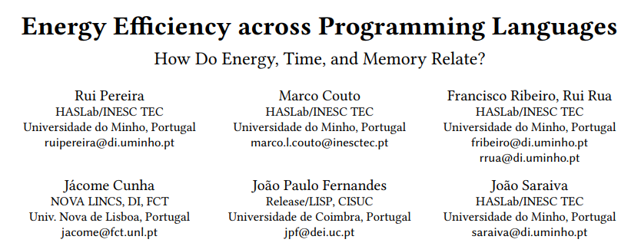
Research Paper
Notes:
Which brings us to the research paper named “Energy Efficiency across Programming Languages” by various authors, which this talk is inspired by.
This paper presents a study of the runtime, memory usage and energy consumption of twenty-seven well-known software languages. They monitored the performance of these languages using ten different algorithmic problems, programmed in each of the languages. The results show the speed of the programming languages, the energy consumption and how it is influenced by memory usage. They also show how to use these results to provide support to decide which language to use when energy efficiency is a concern.

Slide 21
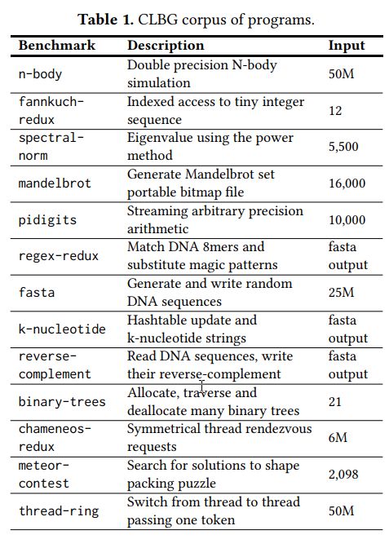
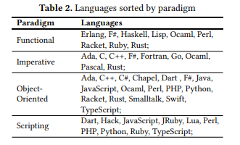
Research Paper
Notes:
These are the algorithms they tested and the programming languages they used. The languages are divided into the categories: functional, imperative, object oriented and scripting.

Slide 22
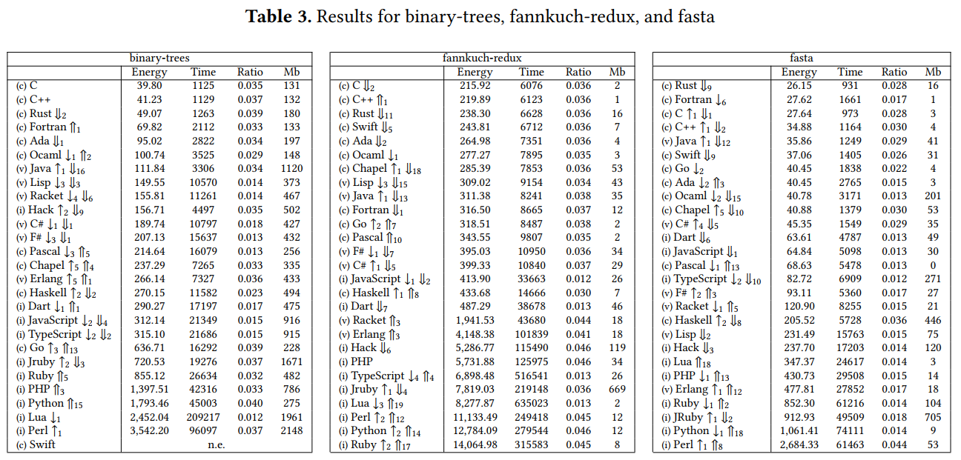
Research Paper
Notes:
And here are the results of two different algorithms for all the programming languages.

Slide 23
Research Paper
Notes:
As you can see, and unsurprisingly, the tables are led by the languages that are compiled directly to machine code. Although the most energy efficient language in each benchmark is almost always the fastest one, there is no language consistently better than the others. The paper also analyzes if maybe the memory consumption has an impact on the power consumption, as the fastest languages also used the least memory, but found no correlation. It seems like runtime is the biggest factor on energy consumption.
I will provide a link to this paper in the sources section at the end of this slide deck, if you want to check it out yourself.
Now I will see if I can replicate these results. I also want to analyze for ourselves if I could find best practices for green programming.

Slide 24
The Algorithms
Notes:
We looked for an algorithm that is easy to implement in different languages but complex enough to actually measure something. Additionally, the algorithm should not be standard so that there is no highly optimized library function for that. We decided to go for two small functions: the Monte Carlo simulation to approximate pi. And the Adler-32 algorithm to calculate checksums.

Slide 25
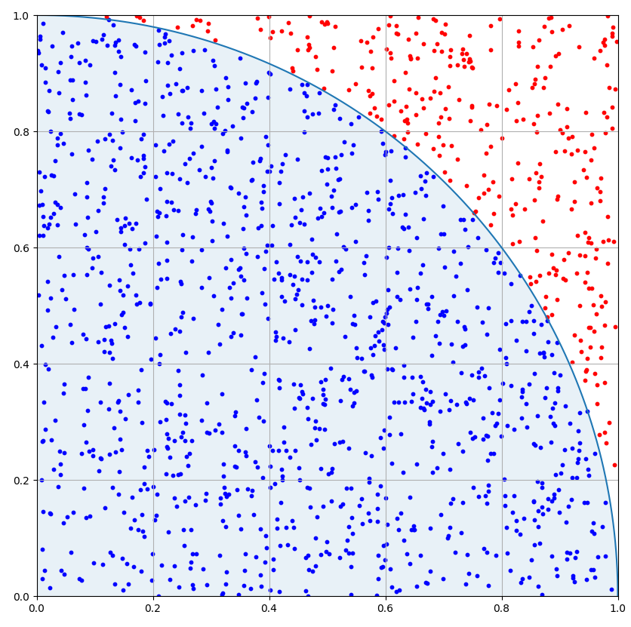
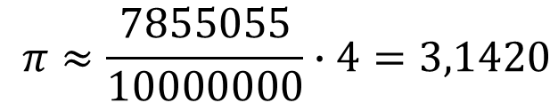
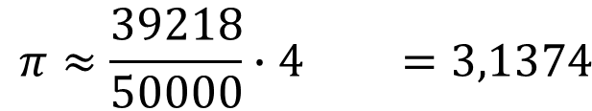
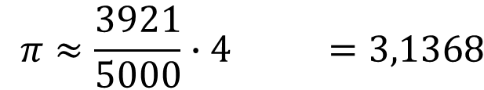
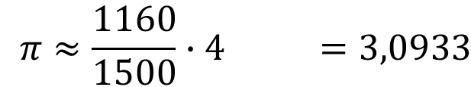
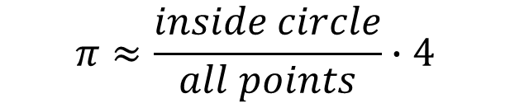
Monte Carlo Simulation
$$π≈\frac{1160}{1500}∙4 =3,0933$$
$$π≈\frac{3921}{5000}∙4 =3,1368$$
$$π≈\frac{inside circle}{all points}∙4$$
$$π≈\frac{39218}{50000}∙4 =3,1374$$
$$π≈\frac{7855055}{10000000}∙4=3,1420$$
Notes:
Let’s start with the Monte Carlo simulation to approximate pi to compare the speed of different programming languages.
Monte Carlo Methods are a class of algorithms that rely on random data to approximate numerical results. They are mainly used in optimization, numerical integration and generating draws from a probability distribution. Monte Carlo methods are used in various fields of science, engineering, mathematics, physics, chemistry, biology, statistics, AI, finance and cryptography. Even in social sciences, like sociology, psychology and political science.
How does the Monte Carlo approximation of pi work? We have the first quadrant of a unit circle in a unit square. Then we generate random points inside this quadrant with uniform probability and count how many of them are inside the circle. Pi is approximately the number of points inside the circle divided by all points, times four.
(Cl) When we do that with 1’500 points, pi is around three dot zero nine.
(Cl) For 5’000 points, pi is around three dot one three.
(Cl) For 50’000 points, pi is still around three dot one three. Not a big change here.
(Cl) For 10’000’000 points, pi is around three dot one four. Now I am getting close.
For the time measurements we used 10 million samples.

Slide 26
Monte Carlo Simulation
auto montecarlo_pi(const int num_iterations)
{
auto rand = std::random_device();
auto random_engine = std::default_random_engine(rand());
auto uniform_dist = std::uniform_real_distribution(0.0, 1.0);
auto count_inside = 0;
for (int i = 0; i < num_iterations; ++i)
{
const auto x = uniform_dist(random_engine);
const auto y = uniform_dist(random_engine);
if ((x * x + y * y) <= 1.0)
{
++count_inside;
}
}
return 4.0 * count_inside / static_cast<double>(num_iterations);
}
Notes:
To implement this, we first need to specify how we want to generate the random numbers. (Cl) I use the standard random device, default random engine, which is the mersenne twister engine according to the C++ standard, and a uniform real distribution from zero to one.
(Cl) Next, I have a for-loop until I reach the number of iterations. I don’t need the looping variable.
(Cl) Within the loop I generate random x and y coordinates. These will form the points. If the points are within the circle, I increment the count variable.
(Cl) In the end, I return four times the number of points inside the circle, divided by the number of iterations, which is the number of all points.

Slide 27
Monte Carlo Simulation
auto montecarlo_pi(const int num_iterations)
{
auto rand = std::random_device();
auto random_engine = std::default_random_engine(rand());
auto uniform_dist = std::uniform_real_distribution(0.0, 1.0);
auto count_range = std::views::iota(0, num_iterations)
| std::views::filter([&](const auto) {
const auto x = uniform_dist(random_engine);
const auto y = uniform_dist(random_engine);
return (x * x + y * y) <= 1.0;
});
return 4.0 * std::ranges::distance(count_range) / static_cast<double>(num_iterations);
}
Notes:
If you know me, you know that if I see a loop, I’m going to rangify it! The beginning of the function is the same. I still need the random generator, engine and uniform distribution.
Now, the for-loop can be replaced by an iota view. I use the filter view and discard the loop variable. Within the lambda of the filter view, I generate the random numbers and check, if the point is within the circle.
To count the number of values within the circle I use ranges distance. And then I return the approximated pi value.

Slide 28
Monte Carlo Simulation
def monte_carlo_pi(num_iterations):
inside_circle = 0
for _ in range(num_iterations):
x = random.uniform(0, 1)
y = random.uniform(0, 1)
if x * x + y * y <= 1.0:
inside_circle += 1
return 4.0 * inside_circle / num_iterations
Notes:
We implemented this algorithm in 12 different programming languages. Here is the Python version.
I’m not going to show all of the different programming languages here. But if you want to have a look at them, I’ll link the repository in one of the next slides.

Slide 29
Adler-32 Checksum
uint32_t adler32(const std::vector<uint8_t>& data)
{
constexpr uint32_t mod_adler = 65521;
uint32_t a = 1;
uint32_t b = 0;
for (size_t i = 0; i < data.size(); ++i)
{
a = (a + data[i]) % mod_adler;
b = (b + a) % mod_adler;
}
return (b << 16) | a;
}
Notes:
We also implemented a second algorithm, the adler 32 checksum
It is a simple algorithm for calculating checksums, based on the Fletcher Checksum. It was invented by Mark Adler and is used, for example, in the zlib library.
The input of the algorithm is a byte vector and the result is a 32 bit integer which is made from two 16 bit integers.
(Cl) The parameter a is initialized with one and in each step the value of the next byte to be checked is added up.
(Cl) The parameter b is initialized with zero and the current value of parameter a is added up in each step.
Both sums will be calculated modulo 65521, which is the biggest prime number that is smaller than 2 to the power of 16.
(Cl) The result will be the combination of the 16 bits of b and a, into a 32 bit integer.
Now the real question is: where is the range? It’s in the sum of b, which is a fold left.

Slide 30
Adler-32 Checksum
uint32_t adler32_ranges(const std::vector<uint8_t>& data)
{
constexpr uint32_t mod_adler = 65521;
uint32_t a = 1;
const auto b = std::ranges::fold_left(data, 0, [&](const auto sum, const auto d) {
a = (a + d) % mod_adler;
return (sum + a) % mod_adler;
});
return (b << 16) | a;
}
Notes:
This is the rangified version. It uses a fold left to sum up the values of b. This gets rid of the for-loop and also makes b const. (short break)

Slide 31
Adler-32 Checksum
def adler32(data):
mod_adler = 65521
a = 1
b = 0
for byte in data:
a = (a + byte) % mod_adler
b = (b + a) % mod_adler
return (b << 16) | a
Notes:
We also implemented this algorithm in all 12 different programming languages. Here is the Python version.
If you want to review all versions of all programming languages, you can go to our github using the QR code on the bottom right corner of the slide. We uploaded all the code examples and the code to reproduce the results there.

Slide 32
Measurements
Notes:
Now that we know what algorithm we want to use we need to talk about the rest of the experimental setup: What programming languages do we want to use, how can we measure the energy consumption of relevant components like the processor and the RAM and how are CO2 emissions calculated.

Slide 33
Programming Language Categories
machine code
byte code
interpreted code
manual memory
garbage collector
C++
Java
Lisp
Notes:
One of the many ways for categorizing programming languages is to look at how they execute code. Some languages like C, C++ or Rust are compiled to machine code which is directly executed by the processor. They also hand over the management of the program’s memory to the developer. These things are often believed to create the fastest programs. (Cl)
Other languages, like Java, compile to byte code which is executed by a specialized virtual machine. It may figure out hot paths during run time and optimize the byte code accordingly. These languages usually manage memory via garbage collection, so that the developer does not need to consider this aspect in their code. (Cl)
Some other languages, like Lisp, interpret the code line by line. We want to include at least one language of each category, but we found that Lisp is too slow in comparison and left it out in the end.
If the execution of the program involves additional components, which run alongside the program, these components will also consume energy. This can be the case for the garbage collector, the VM executing the byte code or the interpreter.

Slide 34
Chosen Programming Languages
C
D
Ruby
Kotlin
C++
Rust
Elixir
Typescript
C#
Python
Java
Lua
Notes:
We used the programming languages which you can see here on the slide. It is a good mix of the different categories just mentioned.
All languages receive the exact same data as input to execute the algorithms. The languages differ in their calculation and memory management and how their standard library is implemented. The algorithms are using different built-in functionalities and standard library functions, like generating random numbers. For C++ I will look also into different implementations: One with std::ranges and one without. We thought it might be interesting to see if using different parts of the standard library might yield different results.

Slide 35
Measurement setup
All code runs within Windows Subsystem for Linux 2
8 GB RAM
Intel Core i7-7700K Cpu @ 4.20 GHz with 8 cores
Monte Carlo Pi for 10 million iterations
Adler32 checksum for 50 MB data
Notes:
Everything is executed on a machine with an Intel Core i7 processor and 8 GB RAM. The computer is a Windows machine but the code is executed within the WSL. All programming language receive the same input, which are 10 million iterations for Monte Carlo Pi and 50 MB data for the Adler32 checksum. This is hard coded into the source code. No file access or network communication is done. The only IO done is printing the results to the console standard output after the calculation has finished.

Slide 36
Code Carbon
CodeCarbon Python Extension
CodeCarbon assumes 3 Watts for 8 GB of RAM
Tracks Intel and AMD processors energy consumption
Directly via Intel power Gadget, RAPL files or the powermetrics tool
Fallback: 50 % of TDP of the processor
Nvidia GPUs are tracked via pynvml
CO₂ emission via energy mix per country
Compilation is not part of the measurement
Periphery is also not measured
Notes:
We use the CodeCarbon Python package for tracking and calculating the energy consumption and CO2 emissions. We run all examples for the different programming languages from a central python script and measure only the execution time. The compile step is not part of the measurements, if there is any.
CodeCarbon can track the energy consumption of RAM via an assumption of 3 Watts per 8 GB of RAM used. The CPU is measured via the Intel power Gadget for Windows or via RAPL files for Linux. If you are running a MAC with Apple Silicon Chips the power metrics tool is used for tracking.
If non of these is available CodeCarbon will look up the processor in its database with over 2000 Intel and AMD CPUs and retrieve its thermal design power or TDP. It will then assume a constant energy usage which is 50 % of the CPUs TDP which is an empirically tested value coming from the authors of CodeCarbon. The GPU can also be tracked and measured directly for NVIDIA GPUS. This is done via the pynvml package. Note that we did not do any programming for the GPU. For estimating the CO2 emission, the energy consumption of program is used to together with a database of energy production mixes for different countries. Your geolocation is determined automatically for this calculation. Monitors and other periphery consume energy as well but are not considered by CodeCarbon.

Slide 37
Code Carbon Code
from codecarbon import EmissionsTracker
import os
import subprocess
os.system("dotnet build -c Release ./csharp/MonteCarloPi") # compilation step (not measured)
with EmissionsTracker(project_name="csharp") as tracker:
os.system("dotnet run -c Release --project ./csharp/MonteCarloPi/") # execution step (measured)
with EmissionsTracker(project_name="python") as tracker:
os.system("python3 python/montecarlopi.py")
...
Notes:
We rely on one single Python script which compiles and executes all languages in one place for convenience reasons. Only the execution time of the algorithm is measured.
This is done by using the „EmissionsTracker“ context manager like in the example above: All code within the context manager is measured and CodeCarbon will automatically figure out how to measure CPU, RAM and GPU energy consumption. With these values it will calculate the CO2 emissions based on your current geolocation. After the Python script is finished CodeCarbon will create one single csv file will all the measurements. If you have several different measurements, it is a good idea to give them names. (Cl) This can be done via the „project name“ argument to the EmissionsTracker.
You can also just measure already compiled programs with CodeCarbon. We choose to put also the compilation step into one single script for convince reasons. It makes rerunning the whole experiment easier when code has been changed.

Slide 38
Code Carbon Offline Mode
from codecarbon import OfflineEmissionsTracker
import os
import subprocess
os.system("dotnet build -c Release ./csharp/MonteCarloPi") # compilation step (not measured)
with OfflineEmissionsTracker(project_name="csharp", country_iso_code="DEU") as tracker:
os.system("dotnet run -c Release --project ./csharp/MonteCarloPi/") # execution step (measured)
Notes:
There is also an alternative to the „EmissionsTracker“ called the „OfflineEmissionsTracker“. It will not automatically determine your geolocation which means you have to provide it yourself via a country iso code. (Cl)
This can be useful if you want to see how your carbon emissions would change by moving your application to another country. For the USA and Canada, also states and provinces can be supplied for more fine-grained results. If you are using the google cloud or are interested in its carbon emissions, you can also provide the google cloud region alternatively and you will get back greenhouse emission data especially for that google cloud region coming from official google data.

Slide 39
How are CO₂ Emissions Calculated
Energy Source | Carbon Intensity (kg/MWh)
Coal | 995
Petroleum | 816
Natural Gas | 743
Geothermal | 38
Hydroelectricty | 26
Nuclear | 29
Solar | 48
Wind | 26
Example country: 60 % coal, 40 % solar: 616.2 kg CO₂ / MWh
Notes:
CodeCarbon uses the carbon intensity (emissions per power usually measured in kg CO2 per MWh) for a country which is published on the scientific online publication “our world in data” for its calculations. But what does this data consist of?
In order to estimate the carbon intensity for a country, information on the energy sources is needed. CodeCarbon uses the table shown in this slide in their explanation of their methodology. The emission data for fossil fuels comes from the US Environmental Protection Agency. Data for the renewable energy sources was obtained from the report „comparison of lifecycle greenhouse gas emissions of various electricity generation sources“ from the world nuclear association. This is an international organization representing companies from the nuclear industry. You might be wondering why things like solar, and wind have a non-zero carbon intensity, because they do not emit any CO2 in their process of generating power. This is because the data used here also considers non-operational carbon emissions from the construction. With this table I can understand how the CO2 emissions for any country are estimated by using their energy mix.

Slide 40
Energy Mixes
Notes:
Let’s have a look at the German energy mix for the year 2023. In the bar plot you can see the energy that was produced in that year in terrawatthours for the different energy sources. Low carbon intensive sources make up about 45 % (forty five percent) of all energy resulting in a carbon intensity for Germany overall of 380 (three hundred and eighty) kg CO2 per MWh . Norway has a completely different energy mix which is dominated by hydroelectricity yielding a much lower carbon intensity of 30 (thirty) kg CO2 per MWh. The UK energy mix yields a carbon intensity in between Norway and Germany with 238 kg CO2 per MWh.

Slide 41
Cloud providers
Google Cloud CO₂ emissions
Renewable energy only AWS regions
AWS carbon footprint dashboard
Emissions Impact Dashboard for Azure
Notes:
On the previous slides we looked at energy mixes and CO2 emissions for the public power grid. This is the energy mix we use on average.
Some companies publish more detailed data on their CO2 emissions. For example, google has a dedicated website where you can look up the carbon intensity and the percentage of renewable energy used for each of their cloud regions. They also mark „low CO2“ regions in this table to help you decide where to host your cloud service. They also offer the possibility to automatically select low carbon regions when you create a new cloud resource. Amazon releases a global carbon footprint and information which of their regions run on 100% renewable energy. But no individual carbon intensity per region is given. Instead, you can access a dashboard with your personal CO2 information in your AWS account. Microsoft offers a dashboard for power BI which calculates and visualizes the greenhouse gas emissions for your Azure cloud usage.

Slide 42
Results
Notes:
Now that I have shown you the setup and what we used for measuring energy consumption and CO2 emissions we are going to look at the results for both the Monte Carlo Pi approximation and the Adler32 checksum.

Slide 43
Results
1 normalized energy unit Monte Carlo Pi | 3.48e-6 kWh
CO₂ emission MonteCarlo (Germany) | 1.33 mg CO₂
CO₂ emission MonteCarlo (Norway) | 0.10 mg CO₂
CO₂ emission MonteCarlo (UK) | 0.83 mg CO₂
Notes:
For visualization purposes we normalized energy consumption by dividing all measured results by the overall minimum value yielding 1 normalized energy unit. All upcoming slides will use this unit which is calculated individually for the Monte Carlo Pi approximation and the adler32 checksum. In the table above you can see the actual values in kilowatt hours and the associated CO2 emissions estimated by CodeCarbon for Germany, that’s where I am from, UK and Norway for comparison.
The decision of choosing where your code is executed can have a huge impact as you can see in these numbers: Without changing a line of code and just by moving from Germany to a data center in Norway, the CO2 footprint of your code would be diminished by a factor of 10.

Slide 44
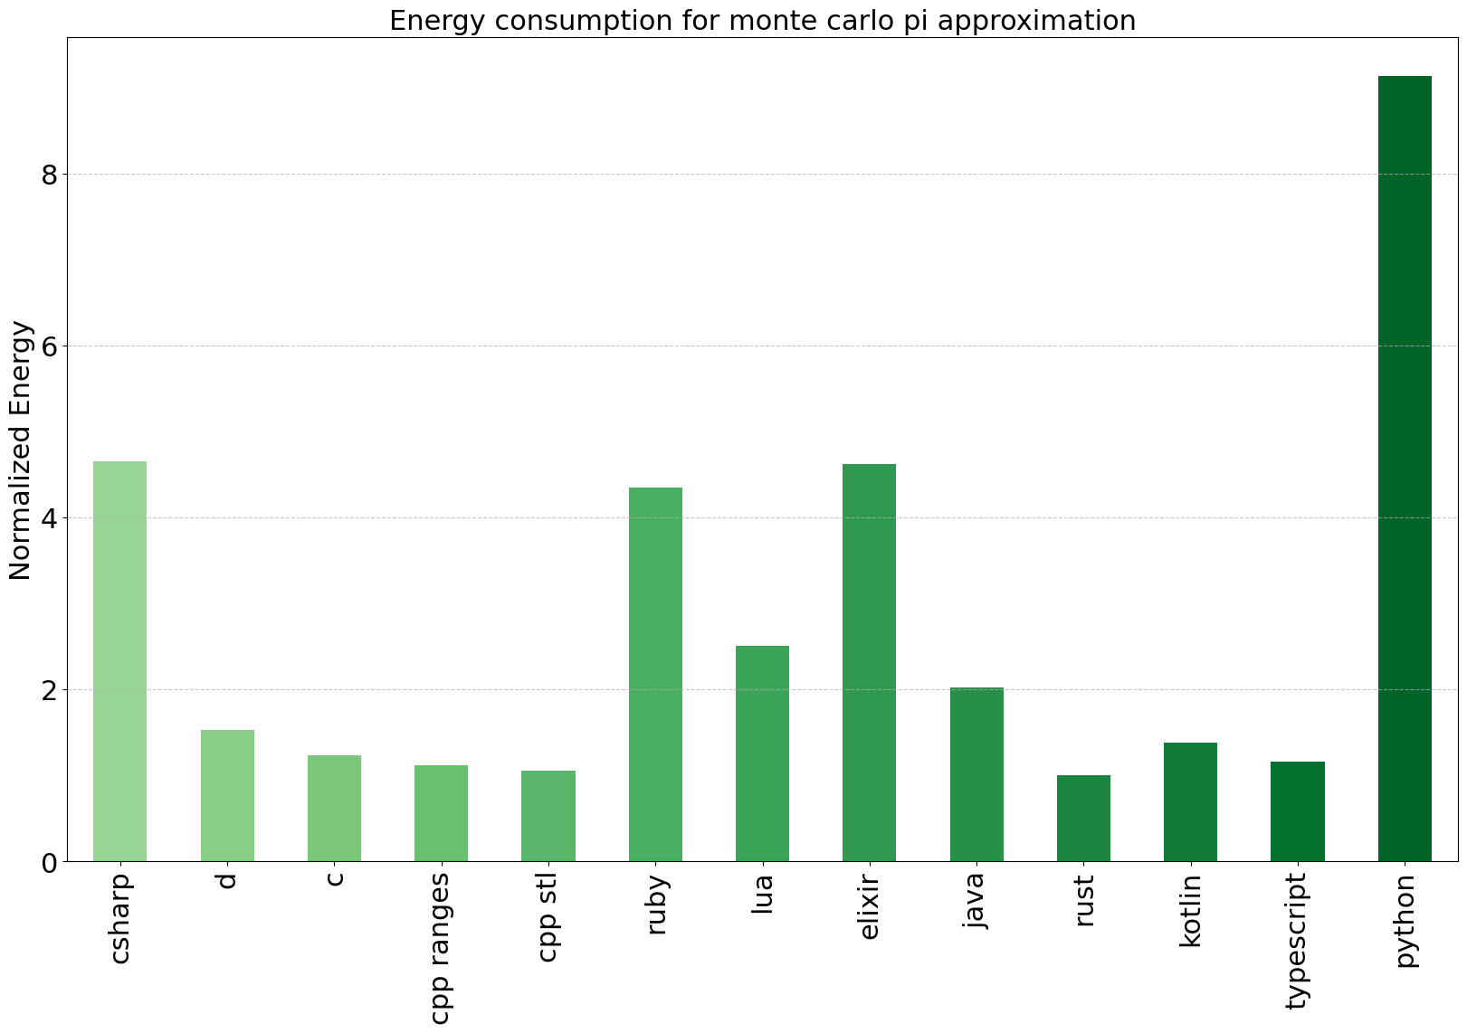
Results Monte Carlo Pi
Notes:
Here are the results from the measurements of the monte carlo pi algorithm for all programming languages I showed. In this plot you see the normalized energy consumption of each program, measured by CodeCarbon.
Just by looking at the bar plot of the results you can see that the compiled languages with manual memory management used the least energy, while python uses the most energy, followed by csharp which are both running on a VM with a garbage collector.

Slide 45
Results Monte Carlo Pi
Language | Norm. total energy | Norm. RAM energy
C++ | 1.06 | 0.55
C++ with ranges | 1.12 | 0.59
C | 1.24 | 0.65
Rust | 1.00 | 0.52
D | 1.53 | 0.80
Typescript | 1.17 | 0.61
Kotlin | 1.38 | 0.72
Python | 9.13 | 3.16
Ruby | 4.35 | 1.65
Lua | 2.50 | 1.31
Elixir | 4.62 | 1.78
Java | 2.02 | 1.06
C# | 4.65 | 1.62
Notes:
Looking at the exact numbers, we see that C, Rust and both C++ variants are very close to each other. In most other experiments of such kind C is usually the best language but we have to take the accuracy of the measurement into account here. Repeating the experiment shows that the numbers can vary by +-0.5 (plus minus zero dot three) after normalization, which means that basically all results within this range cannot be distinguished from one another. If we go beyond individual programming languages, we can find general trends for the categories of programming languages: Compiled languages with manual memory management consume the least energy. There is large variation within the VM based languages like Java, Kotlin, Python. Looking at the numbers, we see that the choice of programming language can influence the energy consumption by a huge factor.

Slide 46
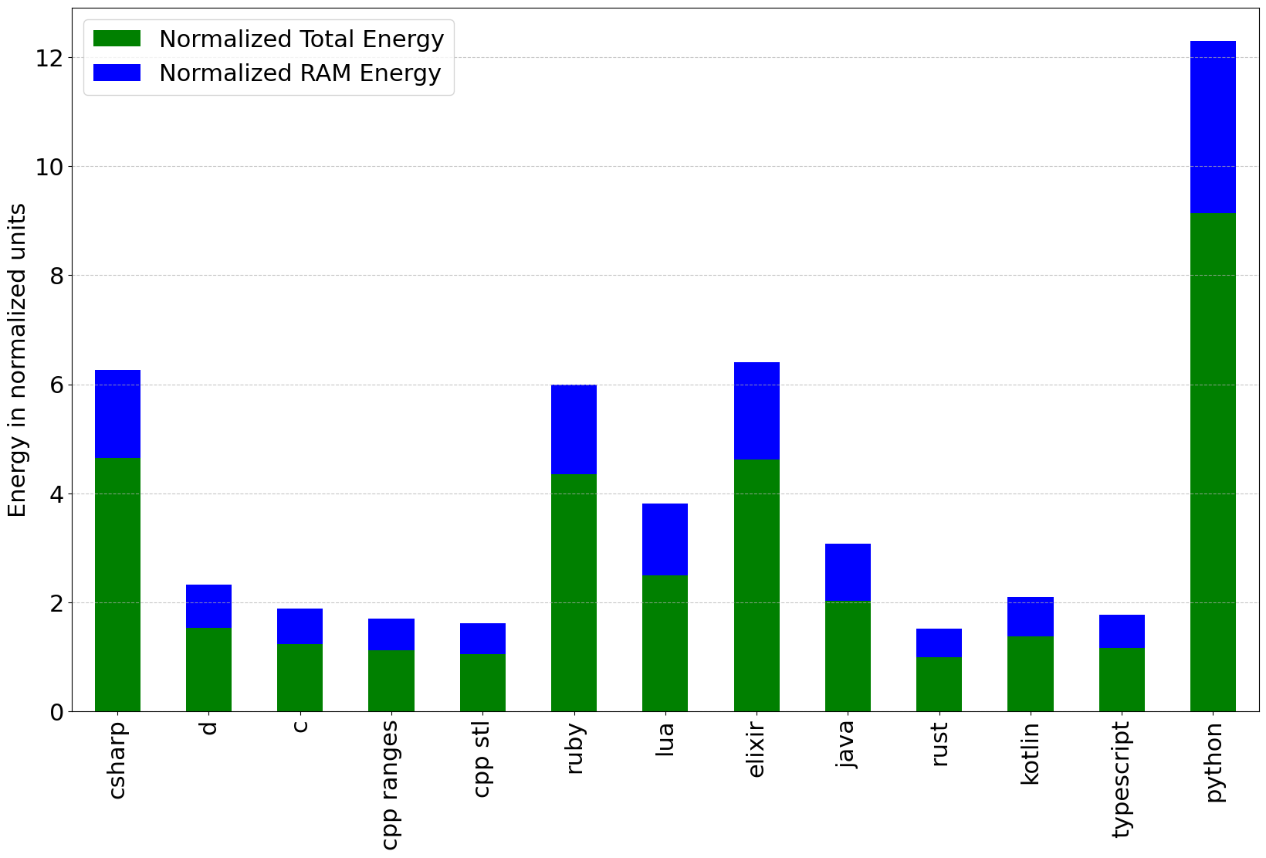
Results Monte Carlo Pi
Notes:
The total energy used is dominated by the CPU. The smaller component is the RAM: C++, C and Rust have the smallest energy footprint for RAM while Python has the highest value. The deviations here are interesting because all languages receive the exact same data and therefore also store the exact same intermediate results. So, the difference here can only come from the way the language stores and manages memory.

Slide 47
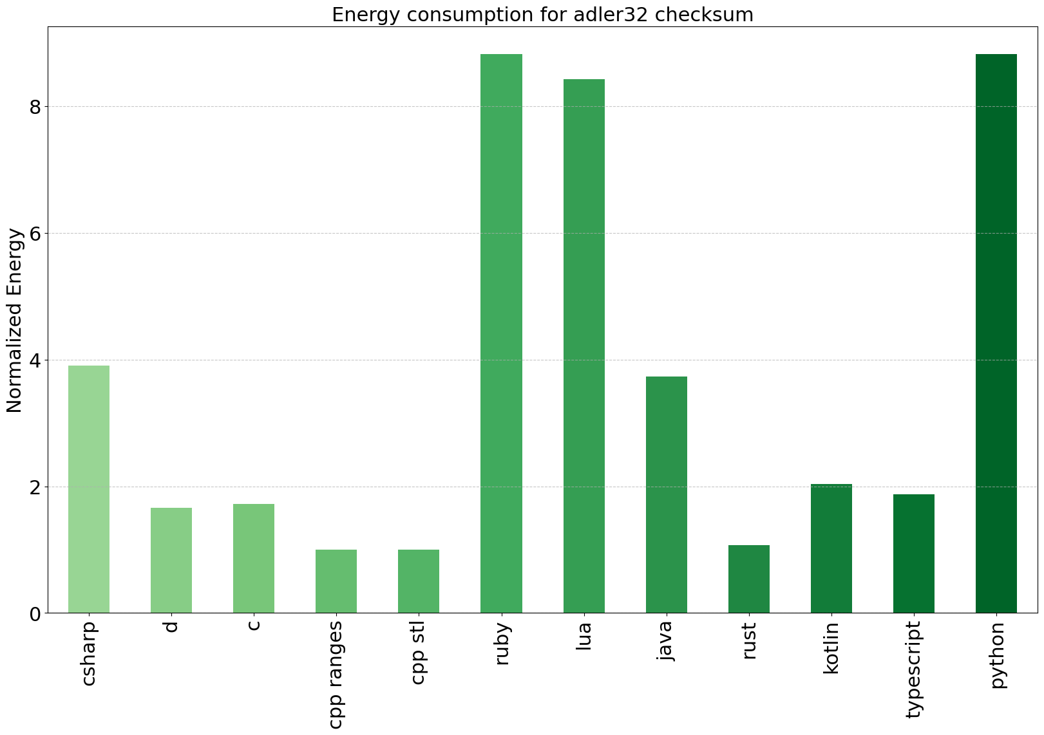
Results Adler32
Notes:
Here are the results from the measurements of the adler32 checksum for all programming languages I showed, except for elixir, which didn’t work. In this plot you see the normalized energy consumption of each program, measured by CodeCarbon. The results are very similar to what I see for the monte carlo pi approximation. Again, the compiled programming languages clearly use the least amount of energy while python uses the most energy.

Slide 48
Results Adler32
Language | Norm. total energy | Norm. RAM energy
C++ | 1.00 | 0.52
C++ with ranges | 1.00 | 0.53
C | 1.72 | 0.90
Rust | 1.07 | 0.56
D | 1.66 | 0.87
Typescript | 1.88 | 0.98
Kotlin | 2.04 | 1.07
Python | 8.83 | 3.19
Ruby | 8.83 | 3.01
Lua | 8.43 | 3.08
Java | 3.74 | 1.43
C# | 3.91 | 1.39
Notes:
Again, the RAM plays the smaller role in the total energy consumption. The CPU makes up the largest part of it.

Slide 49
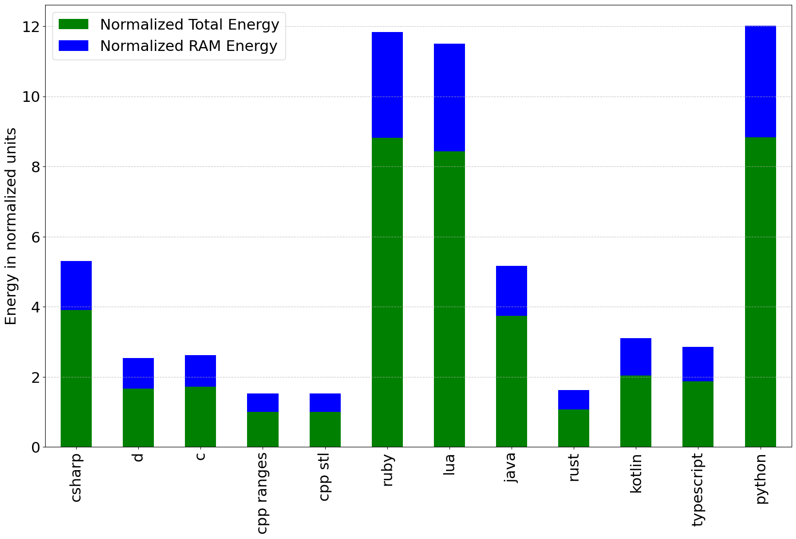
Results Adler32
Notes:
In this experiment the RAM energy consumption is different for the individual languages as well. Compiled languages tend to consume less energy for storing the same amount of data in memory compared to the VM based languages.

Slide 50
Evaluation
Notes:
What can we learn from these results and what can you do to improve the energy and CO2 footprint of your software?

Slide 51
Evaluation
Duration is the main driver of energy consumption
RAM is a small contributing factor
Notes:
The results show that different programming languages have vastly different levels of energy consumption and therefore CO2 usage for the same algorithm and dataset. In our case this was mainly influenced by execution time and a little bit by memory usage, but the results may differ a lot depending on the actual algorithm you want to analyze. We looked at two programs with a focus on computations and loops, without any kind of IO like network or file communication. We also didn’t use the GPU.

Slide 52
Evaluation
Duration is the main driver of energy consumption
RAM is a small contributing factor
Best energy footprint: C, C++
Notes:
As it was shown in the paper, we discussed in the beginning the talk, the smallest energy footprint is achieved by languages which compile to machine code and do manual memory management. In general, it doesn’t seam to matter which of these compiled languages you choose when you want to reduce the CO2 footprint. In the end it comes down to the purpose and what you are most comfortable with.

Slide 53
Evaluation
Duration is the main driver of energy consumption
RAM is a small contributing factor
Best energy footprint: C, C++
Efficient compilers lead to efficient programs
Notes:
The efficiency of a program also comes from a good optimization. For example, it would not bring you much runtime speed if you would compile C++ without any optimizations. C and C++ also profit from highly optimized compilers, which are worked on for decades now. And there are even more specialized compilers, like the Intel C/C++ compiler which utilize hardware acceleration features for even faster programs.

Slide 54
Evaluation
Duration is the main driver of energy consumption
RAM is a small contributing factor
Best energy footprint: C, C++
Efficient compilers lead to efficient programs
No large rewrites
Notes:
If you look at these kind of experiments, you might be tempted to rewrite your software in a language which has a better position in such benchmarks. But this is usually not good idea. A rewrite takes a lot of time and consumes a lot of resources. A large rewrite is most likely not feasible, but optimizing single and computation heavy functions, often is.

Slide 55
Evaluation
Duration is the main driver of energy consumption
RAM is a small contributing factor
Best energy footprint: C, C++
Efficient compilers lead to efficient programs
No large rewrites
Choose the right language for the purpose
Notes:
Not every programming language is suitable for every task. There is a reason, numpy’s performance critical code is written in C, not Python. Numpy can use the best of both worlds, the speed of C and the ease of use of Python. Therefore, the choice of programming language also needs to take the purpose into account. A lot of languages are designed for a specific purpose and it makes no sense to use another language for that.

Slide 56
Evaluation
Duration is the main driver of energy consumption
RAM is a small contributing factor
Best energy footprint: C, C++
Efficient compilers lead to efficient programs
No large rewrites
Choose the right language for the purpose
Use optimized libraries
Notes:
Instead of a rewrite, you can rely on optimized libraries where the core algorithms are written in a language which is compiled to machine code. As mentioned before, in Python you can use numpy for array like operations instead of doing the same in native Python. Numpy is considerably faster than native Python. But keep in mind, that while this can help improve runtime, it will never be as fast as using the compiled languages directly. The pros and cons need to be evaluated from case to case.

Slide 57
Evaluation
Duration is the main driver of energy consumption
RAM is a small contributing factor
Best energy footprint: C, C++
Efficient compilers lead to efficient programs
No large rewrites
Choose the right language for the purpose
Use optimized libraries
Alternative implementations of your language
Notes:
Sometimes also different implementations of your programming language might be available: You could use for example PyPy as a drop-in replacement for CPython. PyPy is usually more performant due to its just in time compiler.

Slide 58
Evaluation
Duration is the main driver of energy consumption
RAM is a small contributing factor
Best energy footprint: C, C++
Efficient compilers lead to efficient programs
No large rewrites
Choose the right language for the purpose
Use optimized libraries
Alternative implementations of your language
Analyze runtime complexity of your algorithm
Notes:
Looking at the theoretical run time complexity of your algorithm and looking for better alternatives is also a good idea. An example here could be sorting algorithms, which vary a lot in complexity.

Slide 59
Evaluation
Duration is the main driver of energy consumption
RAM is a small contributing factor
Best energy footprint: C, C++
Efficient compilers lead to efficient programs
No large rewrites
Choose the right language for the purpose
Use optimized libraries
Alternative implementations of your language
Analyze runtime complexity of your algorithm
Not every program needs to be optimal
Notes:
Also, not every program needs to be highly optimized. If the program is only used by a handful of people twice a year, who cares. That will not make a difference. But algorithm intensive programs that are executed often, will highly profit from optimizing.

Slide 60
Tools
Notes:
I will also highlight some helpful tools.
I develop software for desktop PCs, so energy consumption was never an issue for me before. But if you develop for battery powered devices, like smartphones, energy consumption has always been something to optimize for. Now, this is also gaining some traction for other applications.
I already discussed CodeCarbon, as a very useful tool for measuring the energy consumption and CO2 emission of code due to its versatility. But there are more tools. Please note that all tools are linked in the slides. So when you get the slide deck, just klick on the screenshot of the tool that interests you.

Slide 61
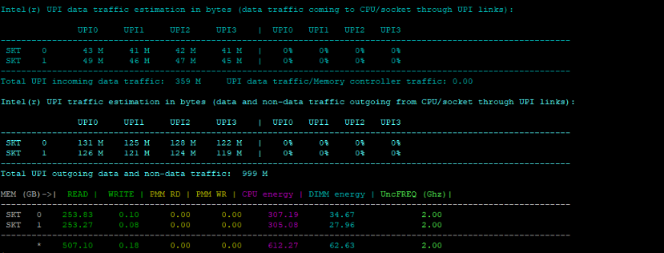
Intel Performance Counter Monitor
Notes:
There is also the Intel Performance Counter Monitor, or PCM: It provides an API and tools to get the energy metrics for a large set of Intel processors.
It runs on many operating systems, including Windows, Mac and Linux.
PCM provides a number of command-line utilities for real-time monitoring. With its basic processor monitoring utility tool you can measure all sorts of things, including the CPU and memory energy consumption.

Slide 62
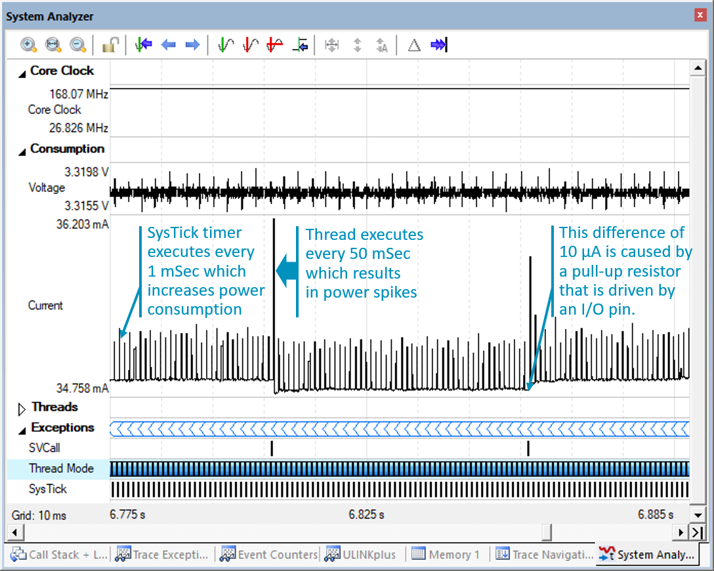
ARM Development Studio
Notes:
The ARM Development Studio is an embedded C/C++ development toolchain designed specifically for Arm-based chips, from tiny microcontrollers to custom multicore processors. With the ARM development studio come many tools, like ULINKpro. Part of ulink is a tool that measures power consumption. You see the system analyser here in the screenshot.

Slide 63
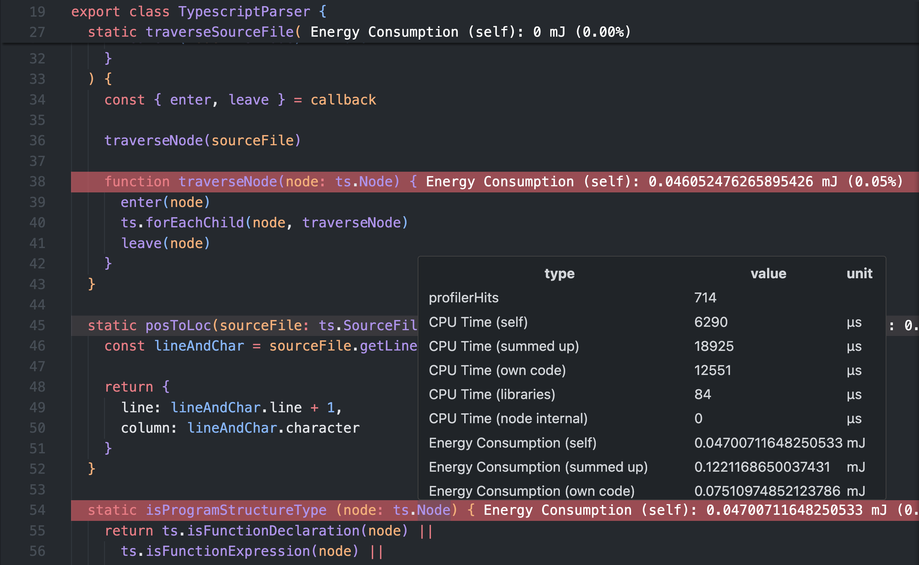
Oaklean
Notes:
And lastly, Oaklean is an energy profiling tool for JavaScript and TypeScript applications. It creates detailed measurements of CPU time, CPU energy consumption and RAM energy consumption for each component of the application. It is integrated into VS code and can show the energy consumption directly in the source code, down to the exact line of code or library call. It can also be integrated into your tests. For this Jest is currently supported.
There are a lot more tools which are specialized for certain programming languages or environments like cloud or Kubernetes. You can find a list in the green software foundation GitHub repository.

Slide 64
More than CO₂
Notes:
Now I have talked a lot about the CO2 footprint of software. While greenhouse gas emissions are the main driver of climate change, there are also other environmental aspects of our modern digital world. I will briefly look into the water usage of data centers and the environmental costs of hardware manufacturing.

Slide 65
Water Usage
Data center consume water in two ways
Indirectly through using power
Directly cooling and humidification
Data Centers are in the top 10 water-consuming commercial industries in the US
Areas with lots of renewable energy in the US are often water stress regions
Nature study estimates 57 % consumption drawn from drinking water (2019)
Notes:
First, let’s look at the issue of water usage. There are two ways in which data centers use water:
The first one is indirectly by using power to operate their infrastructure. The production of power in plants consumes water. Fossil fuel and nuclear power plants convert water into steam, using heat from their energy source and the steam rotates a turbine, which then generates electricity. Water is lost in this process due to evaporation or discharged as effluent. Also, hydropower power plants loose water due to evaporation from open tanks.
Direct water consumption of data centers is the result of cooling: IT equipment produces heat during its operation. To prevent equipment failure, the temperature in data centers needs to be kept at room temperature or below. This is usually done by cooling the air using cold water which results in water loss due to evaporation. Another direct water usage is humidifying the air in data centers because dry air increases the likelihood of electrostatic discharge which can severely damage or destroy IT equipment. A study from Virginia Tech estimates that indirect usage makes up 75 % of data center water consumption in the US while direct water usage only makes up 25 %.

Slide 66
Water Usage
Data center consume water in two ways
Indirectly through using power
Directly cooling and humidification
Data Centers are in the top 10 water-consuming commercial industries in the US
Areas with lots of renewable energy in the US are often water stress regions
Nature study estimates 57 % consumption drawn from drinking water (2019)
Notes:
Large water consumption can lead to environmental problems because less than 1% of water on earth is available for human consumption. In the US, data centers are among the top 10 water-consuming industries. There is an incentive to place them in regions with lots of solar energy sources, which are oftentimes regions where water is scarce, so called „water stress regions“. A nature study estimates that the percentage of drinking water in direct water usage of data centers in the US was fifty-seven percent in 2019.

Slide 67
Water Usage Mitigation
All major cloud providers have pledged to be „water positive“ by 2030
Personal contribution: Efficient software and choice
Notes:
All major cloud providers have stated that they want to be water positive by the year 2030. This means that they want to return more water than they use directly. Their main ways of doing that are: Increasing the efficiency of their cooling systems, moving to lower percentage of fresh water by using more recycled water and funding water replenishment projects.
Our personal contribution to reduce water consumption is the same as for reducing the carbon footprint: By writing greener software I can contribute to lower the computational resources which helps reducing direct and indirect water usage. On the other hand, I can also study the environmental reports of cloud providers and make a conscious decision on choosing a suitable data center.

Slide 68
Hardware Manufacturing
New server: up to 1750 kg CO₂ due to mining, manufacturing and transport
Some raw materials used for IT equipment are scarce
Mitigation: Green software and choice
Notes:
The result of increasing computational demand is that more and more devices are produced and purchased. There are several environmental aspects associated with the production of IT equipment: Firstly, all processes in the chain of production, like mining the raw resources, the manufacturing process itself and the transport of the resources and the final equipment, have a CO2 footprint. This can add up to about one-thousand-seven-hundred-fifty kg CO2 for a single server. And secondly, mining for scarce resources has a direct environmental impact due to erosion, loss of biodiversity and contamination.
Mitigating the environmental footprint of hardware manufacturing also has the same components as water usage mitigation: By writing green software you minimize the usage of computational resources and help minimize the demand for new hardware. On the other hand, you should again search and study the environmental reports of your cloud provider. There they will mention their strategies for a circular economy like recycling, reselling equipment on the secondary market, prolonging the lifetime of equipment and waste management.

Slide 69
Going Greener
Notes:
Change cannot happen overnight, but there are small steps that we can do if we want our software products to be more environment friendly. So, I also want to share some strategies that you can implement to move to a greener product.

Slide 70
Going Greener
Green Software by design
Notes:
Green software by design: Keep green software practices in mind from the very beginning of every new product. You can start by educating yourself and your team about green software and bring it to the discussion directly when a new project starts. At that time only a few decisions have been made and it might be able to implement “green software measures” into your project.
If a product is already in the world, it’s way harder to make changes, or justify the expense of transforming them.

Slide 71
Going Greener
Green Software by design
Green Requirements
Notes:
Green requirements: How can requirements be green or greener? For example, by only requiring what the customer actually needs. Requirement management is a really complicated topic and trying to figure out what the customer really wants, is not easy. But it pays out. Not just in saving of development time, but also further down the line. Code that has not been written does not need to be compiled, deployed, tested and maintained. Reducing the workload of every step.
Also, there is the trend of adding AI to everything, even remote controls or coffee machines. It’s doubtful that this is really what the customer wants. New trendy technology should not be added to everything. Here I need to ask ourselves where this requirement comes from, if it’s not from the customer.

Slide 72
Going Greener
Green Software by design
Green Requirements
Rethink accuracy of stored data
Notes:
Rethink the accuracy of stored data. As said in the beginning, everyone and everything collects a lot of data nowadays. The amount of data only grows, which drives the demand of storing the data somewhere. I should rethink if I need all this data and also, if I can reduce the accuracy of that data.
I have an example for this problem in our company. Among other data, I store the wall thickness of pipelines of our pipeline inspection data. The wall thickness is stored in millimeters. The data type is float, with a precision of eight digits. I need to ask ourselves if this precision is needed. What would it mean to store a millimeter value in double? There is always the feeling that I need to be as accurate as possible with our calculations. But the numbers have no real value once they go to micrometer or even nanometer precision.
So, I always have to ask ourselves, which precision is enough. Which datatype is the smallest that we can use, to reduce the overall data. This matters, as a single inspection can have multiple terabytes of data.
And you know, less data means less data to store, copy around and read in for calculations.
This question also applies to data that we store and use within our programs, to optimize RAM usage.

Slide 73
Going Greener
Green Software by design
Green Requirements
Rethink accuracy of stored data
Move to data centers that use renewable energy
Notes:
There are data centers that run on renewable energy. This is a good start when you want to move to a greener product.
As I have shown before, there are services like the google cloud service, where you can look up which cloud region you want to choose, when you want to reduce carbon emissions. Also, more and more companies install their own solar panels to cover their energy demands partially or completely. This is an investment for sure, but it will help to move the overall power generation to renewable energy.

Slide 74
Going Greener
Green Software by design
Green Requirements
Rethink accuracy of stored data
Move to data centers that use renewable energy
Clean up code
Notes:
Clean up code. That can mean, the removal code that is not used anymore, which is a good idea for many reasons. Code that is unused still needs to be compiled, deployed, tested and maintained. This creates a lot of effort. Keeping code that is unused also contributes to code bloat.
Code bloat can make the program less efficient and slower.
This can also happen when software engineering principles are not applied, like reusing functions instead of rewriting or copying them all over the code base.
Another contributing factor is when principles are applied that are not necessary to solve the problem. Like using object-oriented design where it’s not needed, and a procedural approach would have been enough.
This is something that I have to keep a constant eye on as code grows faster that it can be cleaned up or refactored.

Slide 75
Going Greener
Green Software by design
Green Requirements
Rethink accuracy of stored data
Move to data centers that use renewable energy
Clean up code
Clean up data
Notes:
Clean up data. This means that there needs to be a strategy to clean up data, preferably automatically. I think I all know the problem of test systems that write some data to the hard drive and the data needs to be kept there for a while to be able to check the test results. But at some point, it needs to be deleted, otherwise the hard drive will be at some point at capacity. There has to be policies for this because cleaning up manually is a hustle and can be forgotten.
It so tempting to not want to deal with these kinds of issues and just buy a new storage system if the old one is full. But that’s not sustainable and the new data storage will again consume more energy.
This is like the clean up code issue. It has to be constantly worked on, in order to not spiral out of control.

Slide 76
Conclusion
Notes:
To conclude

Slide 77
Conclusion
Worldwide energy consumption is on the rise
AI needs a lot of energy
Fastest programming languages are the most efficient
Runtime and CPU usage is most important
Optimize for what you need
Measure energy consumption of your program
Water consumption and new IT equipment also contribute to environmental damage
Lots of steps can be taken already to go greener
Contribute to a greener future by keeping sustainability in mind
Notes:
Worldwide energy consumption is on the rise. (Cl) This has many reasons, like the acceleration of AI services, especially in the recent years.
(Cl) We saw that programming languages which are compiled directly to machine code are the most time efficient and that correlates directly to the CO2 emissions. (Cl) While RAM plays a role, it’s not nearly as big as the CPU.
(Cl) But there are more things to consider when choosing a programming language, like if it’s fit for your purpose.
(Cl) If this topic is important for you, you can use tools to measure the energy consumption of your program and you can even include this into your testing routine.
(CI) Water consumption and the need of new IT equipment also contribute to environmental damage.
(CI) I also showed how you can already take a lot of small steps in order to have a greener product.
While we cannot influence directly how sustainable the energy of our countries is produced, we can aim to do small steps ourselves. This includes trying to reduce the CO2 footprint of the programs we write by using efficient languages and libraries.
(Cl) This is our own contribution into a greener future.

Slide 78



Tina Ulbrich
Hendrik Niemeyer
@tinaul@mastodon.social
tina_ulbrich@gmx.de
@tinaul.bsky.social
tinaul
@hniemeyer@mastodon.social
heniemeyer@icloud.com
@hniemeyer.bsky.social
hniemeyer
ROSEN Technology and Research GmbH
Notes:
Thank you

Slide 79
Sources
https://www.informatik-aktuell.de/betrieb/server/rechenzentren-energiefresser-oder-effizienzwunder.html
https://www.heise.de/news/Gruenes-Programmieren-C-und-Rust-energieeffizient-Python-und-Perl-Schlusslicht-7259319.html
https://scienceblogs.de/rupture-de-catenaire/2021/05/03/die-energie-effizienz-von-programmiersprachen/
https://greenlab.di.uminho.pt/wp-content/uploads/2017/10/sleFinal.pdf
https://www.goldmansachs.com/insights/articles/AI-poised-to-drive-160-increase-in-power-demand
https://www.enviam-gruppe.de/energiezukunft-ostdeutschland/verbrauch-und-effizienz/stromverbrauch-ki
https://www.datacenter-insider.de/nachhaltigkeit-in-code--tools-sprachen-roadmaps-a-4488612f6f7799531b9ad852d0beff35/
https://datascience.aero/green-programming-reducing-your-carbon-emissions-when-coding/
https://github.com/Green-Software-Foundation/aIsome-green-software
https://sdialliance.org/
https://github.com/intel/pcm
https://developer.arm.com/documentation/101816/0902/Capturing-Energy-Data
https://www.oaklean.io/
https://iopscience.iop.org/article/10.1088/1748-9326/abfba1
https://www.washingtonpost.com/climate-environment/2023/04/25/data-centers-drought-water-use/
https://think.ing.com/articles/data-centres-growth-in-water-consumption-needs-more-attention/

Slide 80
Sources
https://www.nature.com/articles/s41545-021-00101-w
https://nordiccomputer.com/resources/what-is-the-effect-of-datacenter-hardware-on-the-climate
https://en.wikipedia.org/wiki/Environmental_impact_of_mining#:~:text=Mining%20can%20cause%20erosion%2C%20sinkholes,which%20contributes%20to%20climate%20change.
https://datacentersustainability.org/data-centers-and-critical-raw-materials/
https://benchmarksgame-team.pages.debian.net/benchmarksgame/description/fannkuchredux.html#fannkuchredux
https://benchmarksgame-team.pages.debian.net/benchmarksgame/description/fasta.html
https://www.playing4theplanet.org/
https://developer.arm.com/documentation/101636/0100/Power-Measurement/Analyzing-Power-Consumption?lang=en

